Slide 1
COMP 3311 Database Management Systems
Lab 4. Simple DDLs and DMLs, and enforcing constraints

Slide 2
Objectives of the Lab
After this lab you should be able to
Issue simple Data Definition Language commands,
create/ modify tables
Issue simple Data Manipulation Language commands,
insert/ delete/ modify data
Know to apply simple integrity constraints.
2

Slide 3
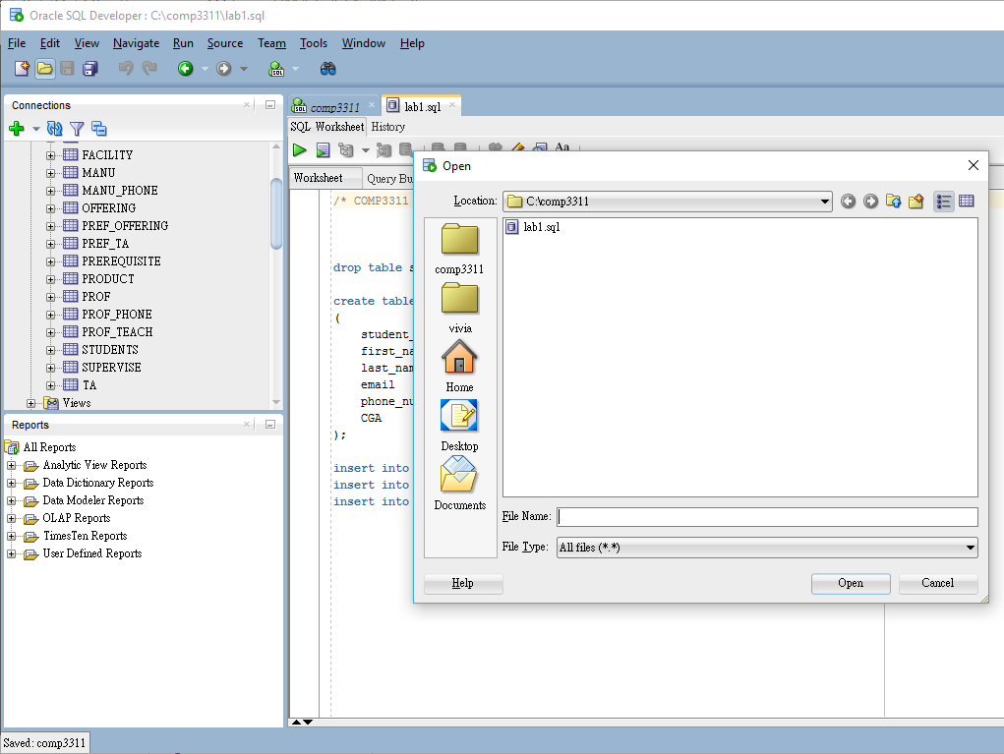
Downloading and running the lab SQL script file
Login Oracle database server using SQL Developer with your Oracle account
Download (save) the lab4.sql file to local file system
Open file
Run script
The tables created last time were dropped.
Some new tables are created.
Test statement can be download from lab4_test.sql
1
4
2
3

Slide 4
Simple Data Definition Language
The Data Definition language (DDL) is a language for specifying the database schemes (in the form of tables). It enables operations to be made on creating tables and altering the tables.
You will learn the following DDLs in this lab.
CREATE
RENAME
DROP
ALTER
4

Slide 5
Simple Data Definition Language
Creating a new table CREATE TABLE table_name ( column1 datatype, column2 datatype, …); create table department_facility ( department_id varchar2(4) not null, name varchar2(40), no_of_projectors number(4), no_of_computers number(5));
Renaming an existing table RENAME old_table TO new_table RENAME department_facility to test;
5

Slide 6
Simple Data Definition Language
Dropping an existing table Drop TABLE table_name; DROP TABLE test;
Adding new columns to an existing table ALTER TABLE table_name ADD ( column1 datatype, column2 datatype,…); ALTER TABLE facility ADD ( funding number(10));
6

Slide 7
Simple Data Definition Language
Changing the data type of the column ALTER TABLE table_name MODIFY (column1 datatype, column2 datatype,…); ALTER TABLE facility MODIFY ( funding varchar2(10));
Deleting a column from an existing table ALTER TABLE table_name DROP (column1,column2,…); ALTER TABLE facility DROP (funding);
7

Slide 8
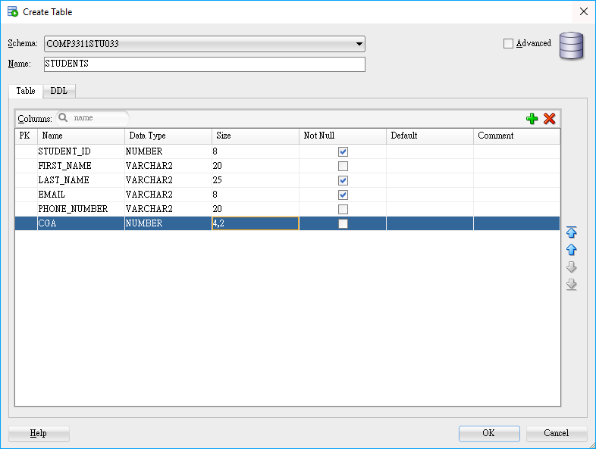
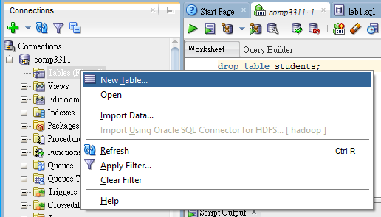
Appendix: Create Table with SQL Developer
Right click on “Tables(Filter)” to display its context menu
Select “New Table” to display a panel for creating a table
Select “add column(+)” and input attributes
edit attritutes
table name
add/remove column
edit column

Slide 9
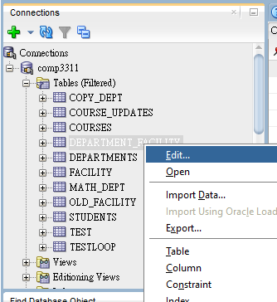
Appendix: Defining Database Schemas with SQL Developer
Right click target table and select edit
9

Slide 10
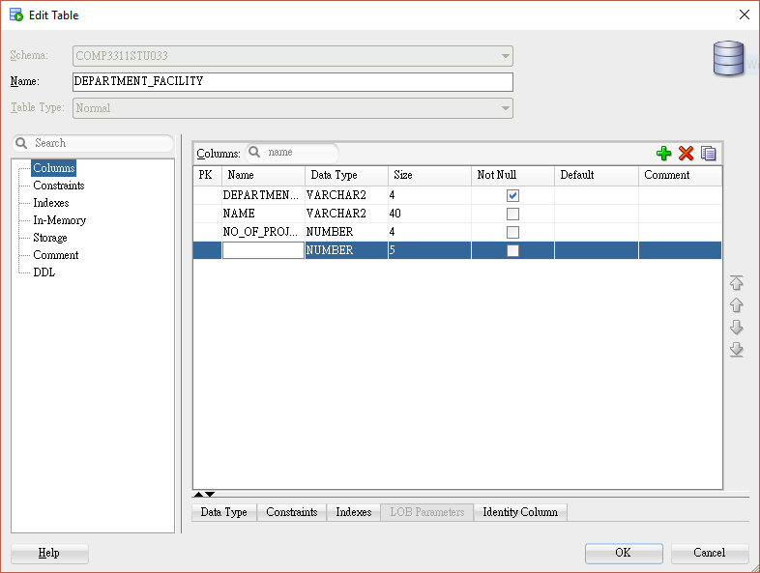
rename table
add/remove column
edit column
10

Slide 11
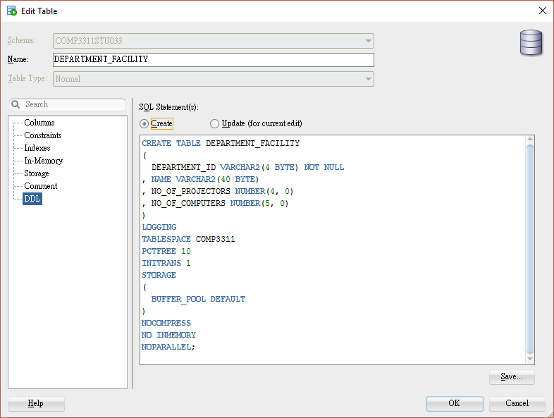
Get DDL from SQL Developer
Open Edit Table dialog
Select DDL
Select Create

Slide 12
Simple Data Manipulation Language
The Data Manipulation language (DML) is a language for manipulating data in a database.
You will learn the following DML in this lab.
INSERT
DELETE
UPDATE
12

Slide 13
Simple Data Manipulation Language
Insert records to an existing table INSERT INTO table_name (column1, column2,…) VALUES (value1, value2,…) INSERT INTO facility (department_id, name, no_of_projectors, no_of_computers) VALUES ('COMP', 'Computer Science', 5, 150);
You can omit the column names, if you are inserting records with all the columns present. INSERT INTO facility VALUES ('COMP', 'Computer Science', 5, 150);
13

Slide 14
Simple Data Manipulation Language
By stating explicitly the columns, you can insert partial records with some of the columns being absent, as long as these columns do not have the “NOT NULL” constraint (will cover the “NOT NULL” constraint in details in the following lab). INSERT INTO facility (department_id) VALUES ('test');
14

Slide 15
Simple Data Manipulation Language
Removing a record from an existing table DELETE FROM table_name [WHERE conditions] DELETE FROM facility WHERE department_id='test' ;
The following statement removes all records from the table facility DELETE FROM facility;
15

Slide 16
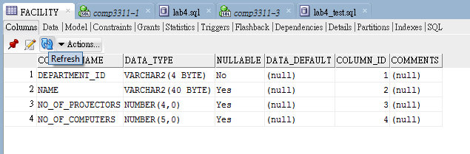
Simple Data Manipulation Language
Updating tuples of an existing table UPDATE table_name SET column= value [WHERE conditions]; UPDATE facility SET no_of_computers=200 WHERE department_id= 'COMP';
Reminder 1 : to test this statement, insert deleted data back before update
Reminder 2 : to view the result from table, refresh data
16

Slide 17
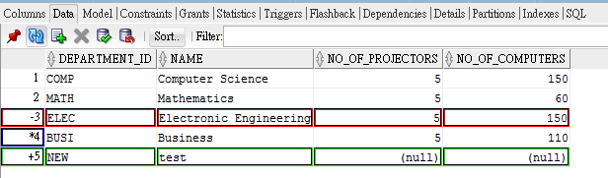
Data Manipulation with SQL Developer 1
Select target table, Select “Data”
Insert: click insert row, empty row will be created after selected row
example: row +5 :NEW
Delete: select target record(s), click delete selected row; click again to undo deletion
example: row -3 : ELEC
17

Slide 18
Data Manipulation with SQL Developer 2
Update: double click on target record
example: row *4 : BUS -> BUSI
Updated rows will be marked (as example on right-hand side), until commitment
18

Slide 19
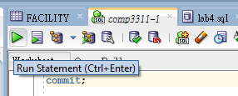
Commit
Method 1: Commit with SQL statement
open SQL worksheet
enter “commit;”
run statement
19

Slide 20
Appendix: Commit alt.
Method 2: Commit with Controls Under the Data tab
Commit Changes ends the current transaction and makes permanent all changes performed in the transaction.
Rollback Changes undoes any work done in the current transaction.
20

Slide 21
Appendix: Other Controls Under the Data tab
Refresh queries the database to update the data display. If a filter is specified, the refresh operation uses the filter.
Sort displays a dialog box for selecting columns to sort by.
Filter enables you to enter a SQL predicate (WHERE clause text without the WHERE keyword) for limiting the display of data. For example, NO_OF_COMPUTERS=60
21

Slide 22
Integrity Constraints 1
We need to ensure that changes made to the database do not disrupt data consistency.
One of the methods is to enforce integrity constraints on the database.
Integrity constraints can be declared at the column level or at the table level.
22

Slide 23
Integrity Constraints 2
Column level constraints apply to the columns only. Each constraint involves one column.
Table level constraints apply to the whole table. Usually involved multi-columns.
In Oracle, column level constraints are placed right after the column definitions. Table level constraints are placed after all the definitions of the columns.
23

Slide 24
Constraint commands
The Constraint commands
PRIMARY KEY: specifies the column(s) that are used to uniquely indentify the rows(records) in a table.
FOREIGN KEY: specifies the column(s) that is/are being “borrowed” from another table and must be present in that table.
UNIQUE: indicates the column has unique values.
NOT NULL: indicates the column must have a value.
CHECK: place conditions (in the form of a predicate) on the column.
Oracle Database allows applying the above constraints at the column level or at the table level (except for the NOT NULL constraint which can only be applied as a column level constraint).
24

Slide 25
Enforcing Integrity Constraints 1
Example 1:
CREATE TABLE staff (
id number(10) PRIMARY KEY,
age number(3) CHECK
(age between 0 and 65),
salary number(10) CHECK
(salary>0));
CREATE TABLE work (
id number(10) REFERENCES staff(id),
firm_name VARCHAR2(100) NOT NULL,
Primary Key(id, firm_name));
Column Level Constraints
Table Level
Constraint
25

Slide 26
Enforcing Integrity Constraints 2
Example 2: The following two statements are identical. Note that all the constraints in the second CREATE statement were given names.
CREATE TABLE work (
id number(10) REFERENCES staff (id),
firm_name VARCHAR2(100) NOT NULL,
Primary Key (id, firm_name)
);
CREATE TABLE work(
id number(10),
firm_name VARCHAR2(100)
CONSTRAINT not_null NOT NULL,
CONSTRAINT f_key FOREIGN KEY (id) REFERENCES staff (id),
CONSTRAINT p_key Primary Key(id, firm_name)
);
26

Slide 27
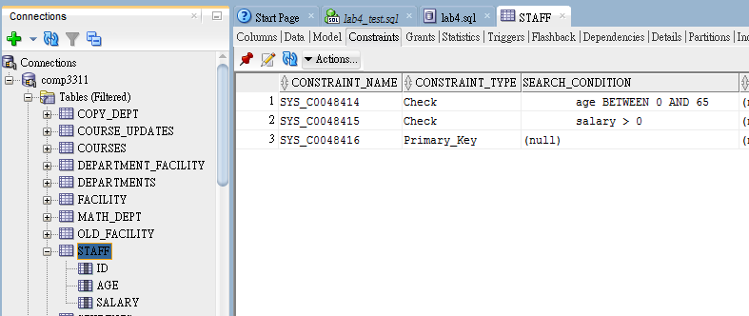
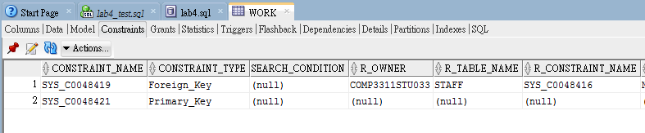
Appendix: Check Integrity Constraints with SQL Developer
You can check the constraints through SQL table Object
Refresh after running SQL statement
2
3
1

Slide 28
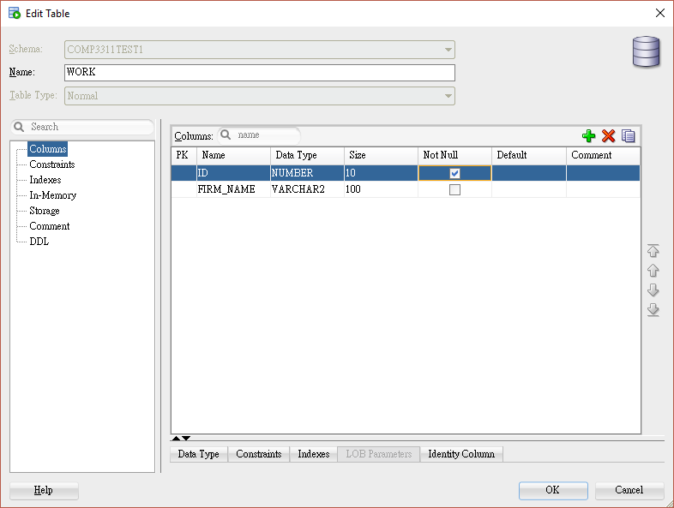

Appendix: Example of Create IC with SQL Developer 1
To create IC as work table in Example 2,
Reminder: drop the previous work table, create a new one without IC (run SQL statements above --**Try to create IC with SQL Developer here**-- in lab4_test.sql) refresh
Create Column level Constraints:
Right click on target table (WORK)
Select “Edit…”
“Edit Table” Dialog opened
Select “Column”
Tick “Not Null” of ID
Click “OK”

Slide 29
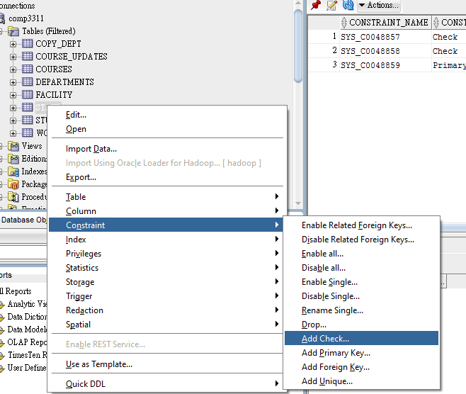
Appendix: Create Integrity Constraints with SQL Developer
Add table level constraints
right click on targe table
select “Constraint"
select Add target constraint

Slide 30
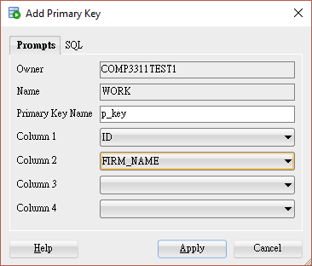
Appendix: Example of Create IC with SQL Developer 2
Add table level constraints
right click on table WORK
select “Constraint" (as P.25)
select Add Primary Key
Primary Key Name: p_key
Column 1 : ID
Column 2 : FIRM_NAME
Click “Apply”
Refresh
30

Slide 31
Appendix: Example of Create IC with SQL Developer 3
foreign key is similar to primary key, try to add the following foreign key back yourself
CONSTRAINT f_key FOREIGN KEY (id) REFERENCES staff (id)
Reminder: add table work back before continue alter IC
31

Slide 32
Modify Integrity Constraints 1
Add constraints in an existing table by their names, using the ALTER TABLE statement.
ALTER TABLE staff ADD CONSTRAINT test CHECK (age between 20 and 40);
Modify constraints in an existing table by their names, using the ALTER TABLE statement.
ALTER TABLE work MODIFY (firm_name null);
32

Slide 33
Modify Integrity Constraints 2
We can drop a non-primary key constraint
ALTER TABLE staff DROP CONSTRAINT test;
We can also drop a primary key
ALTER TABLE work DROP PRIMARY KEY;
Or add it back
ALTER TABLE work MODIFY (PRIMARY KEY (id,firm_name));
We need to remember the constraint name in order to drop it. The following query returns all the declared constraints.
SELECT constraint_name FROM user_constraints;
33

Slide 34
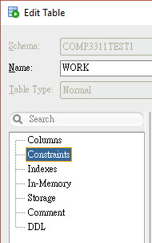
Appendix: Modify Integrity Constraints with SQL Developer
Right click on target table
Select "Edit”
Select “Constraints”
Drop Constraints
Rename Constraints
Example: P_KEY is renamed as NEW_P_KEY
Modify Constraints
F_KEY on delete: “No Action is changed to Cascade”
34

Slide 35
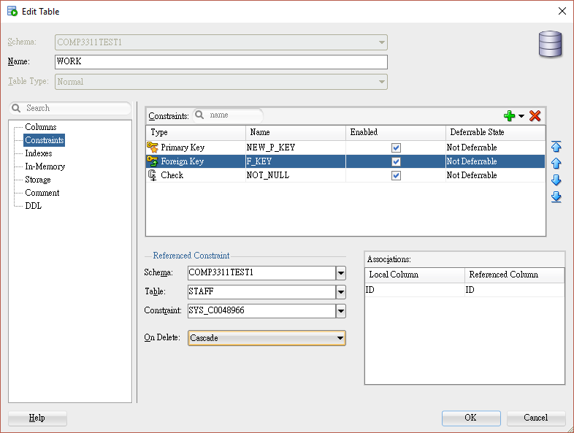
Add constraints
Drop constraints
Rename
Modify Constraints
35

Slide 36
Conclusion
We covered the following topics in this lab:
Simple DDLs and DMLs
Enforcing integrity constraints
Create constraints in table and column level
modify constraints by alter table or edit Table Dialog
36

